Slide 1
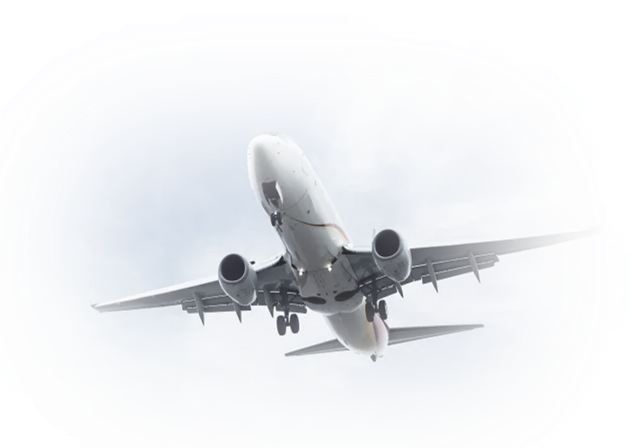
Airline Customer Satisfaction – Data Analysis
Mohammad Shah
Abdul Wasay
Faria Akther
Sumandeep Kaur
Group 15

Slide 2
Overview:
Project Aim
Our Dataset
Pre-processing, and cleaning the dataset for analysis
Analytical Methods
Satisfaction Distribution
Overall Analysis
Class based Analysis
Eco, Eco Plus, Business
Recommendations for Airlines
Conclusion

Slide 3
Project Aim:
Identify the primary factors that enhance customer satisfaction
Compare satisfaction factors across class types, and analyze how customer expectations vary among them
Highlight high impact but low rated service areas

Slide 4

Our Dataset:
Dataset is from a real airline, with the airline name undisclosed, but the data reflects real passenger experiences (dataset is from Kaggle)
Exploring the dataset :
Dataset shape: (129880 rows, 22 cols).
4 object (categorical) columns (e.g. satisfaction, Customer Type, Type of Travel, Class).
18 integer columns (age, ratings, delays, etc.).
1 float column (Arrival Delay in Minutes after imputation).

Slide 5
Data Preprocessing – Handling Missing Values:
Missing Value Check:
Used df.isnull().sum() to count missing values column-wise.
Identified missing values in Arrival Delay in Minutes.

Slide 6
Data Preprocessing – Handling Missing Values:
Imputation Strategy:
Computed the median arrival delay.
Replaced missing values in Arrival Delay in Minutes with this median.
Why Median Imputation?
Median is robust to extreme delay values (outliers).
Avoids dropping rows and losing data.
Keeps the distribution of delays realistic for analysis.

Slide 7

Analytical Methods:
For Statistical Analysis:
Started with setting up factors which needs to be considered to derive insights.
For eg- seat comfort, inflight entertainment, online boarding, check in services etc are some factors considered.
Then we setup the correlation of the overall customer experience and the different seating classes with each factor.
Data Visualisation:
Bar charts are used to present our findings effectively.

Slide 8
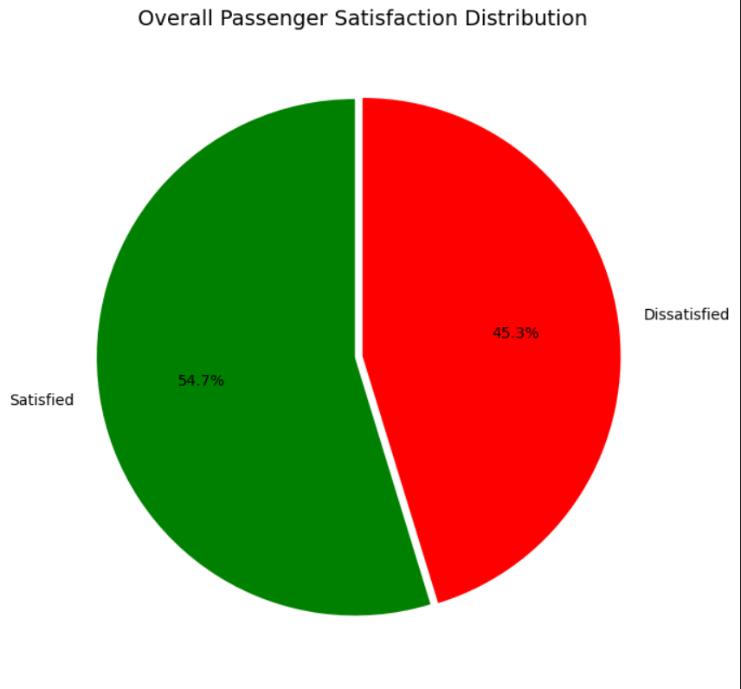
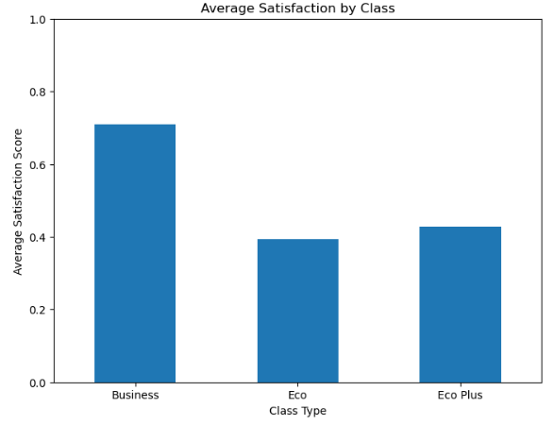
Satisfaction Distribution:

Slide 9
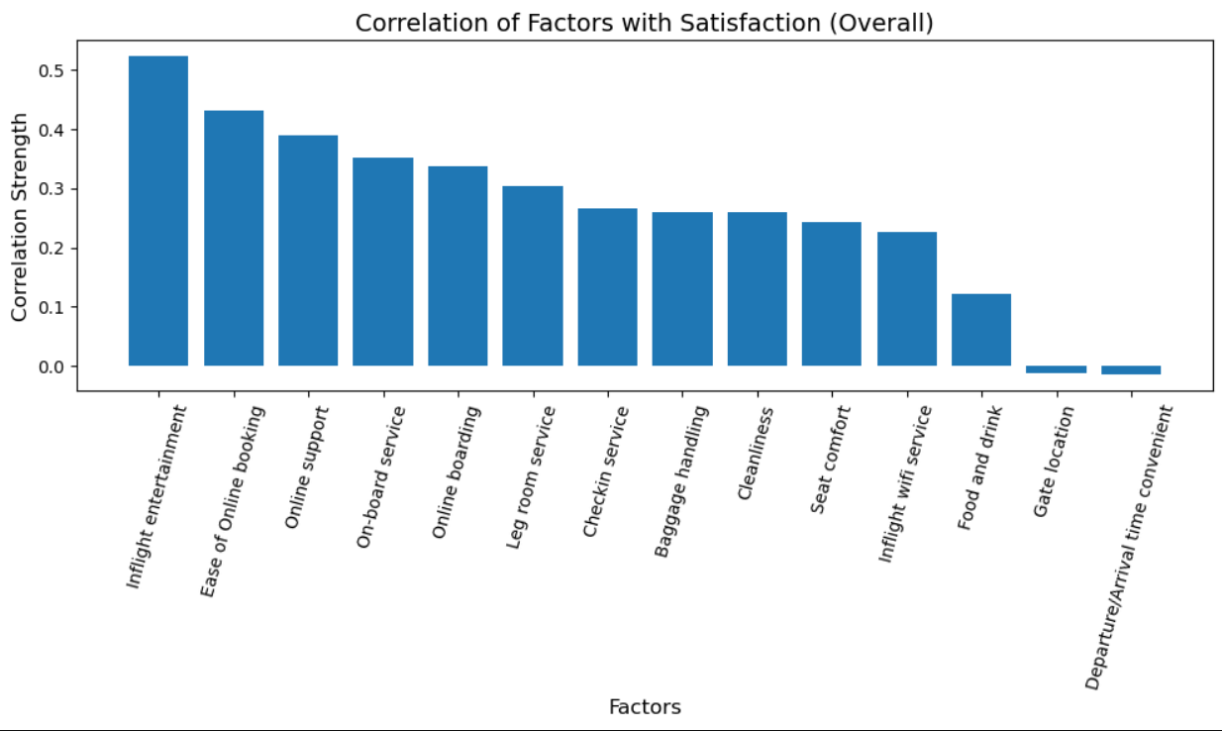
Overall Factor Correlation Analysis:
The ranking highlights two major themes: passengers value digital convenience for the flight, and engaging in-flight experiences during the flight

Slide 10
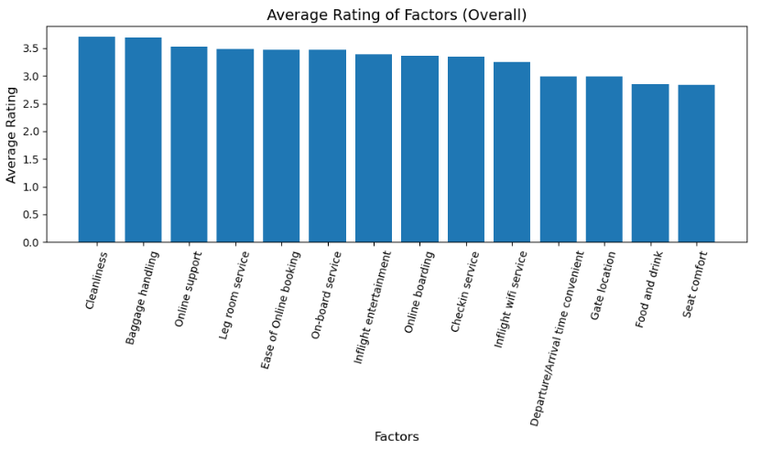
Overall Average Rating:
Shifting from Correlation to average rating shows a new perspective on these factors.
No factors in this dataset reached an average rating of 4 or above.

Slide 11
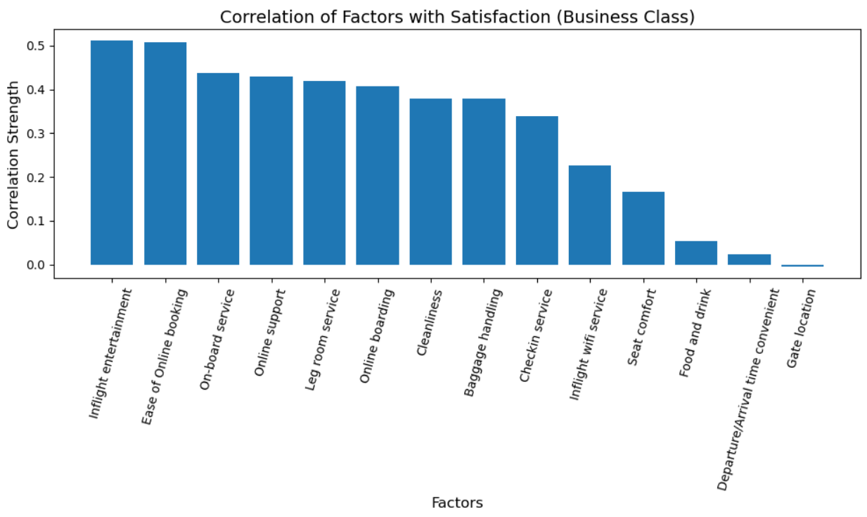
Business Class Factor Correlation Analysis:
Based off the rankings in the bar chart, there is high correlation of inflight entertainment, and ease of online booking, meaning a stronger relationship with customer satisfaction.

Slide 12
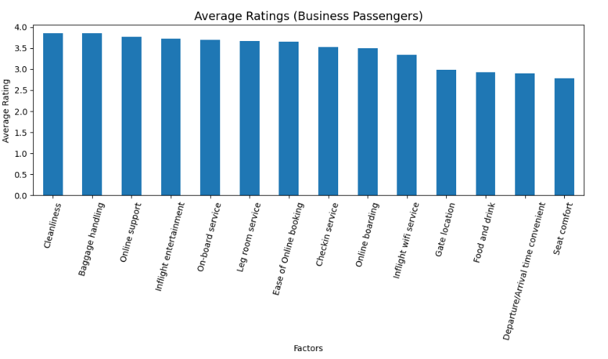
Business Class Average Rating:
In average ratings for Business Class we see cleanliness and baggage handling scoring highest, while food & drink and seat comfort have the lowest score.
From Gate location onwards we see a greater drop in rating

Slide 13
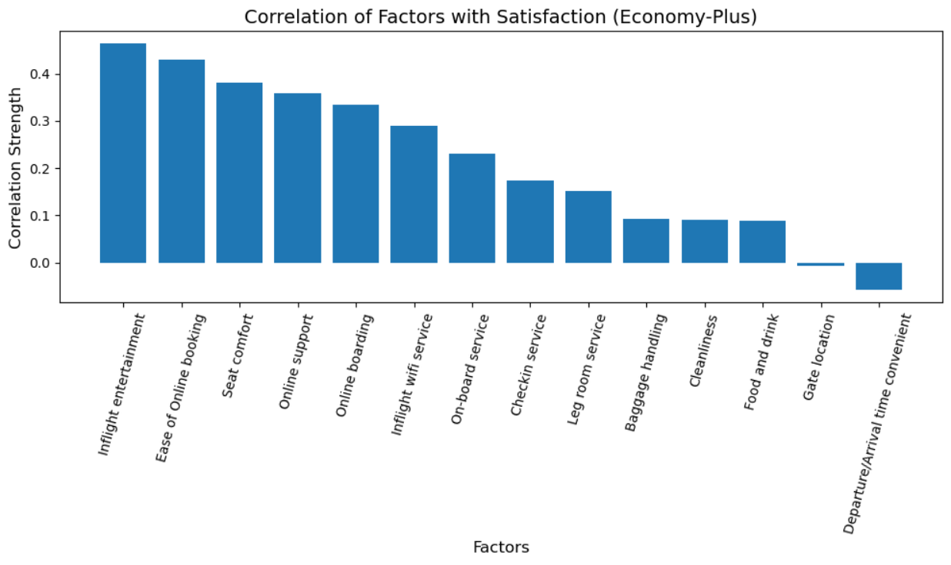
Economy-Plus Factor Correlation Analysis:
Inflight entertainment, online booking ease, and seat comfort display the strongest positive correlations.
Similar to overall correlation, we see Inflight entertainment, online booking ease take the top two spots.

Slide 14
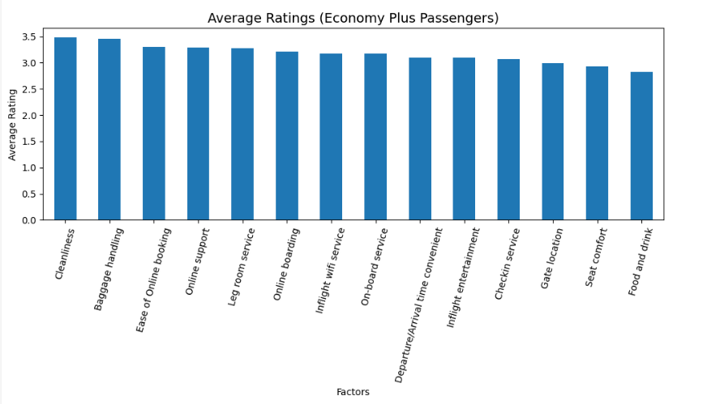
Economy-Plus Average Rating:
Cleanliness and baggage handling are rated as the strongest average rating, while and food & drink receiving the lowest.

Slide 15
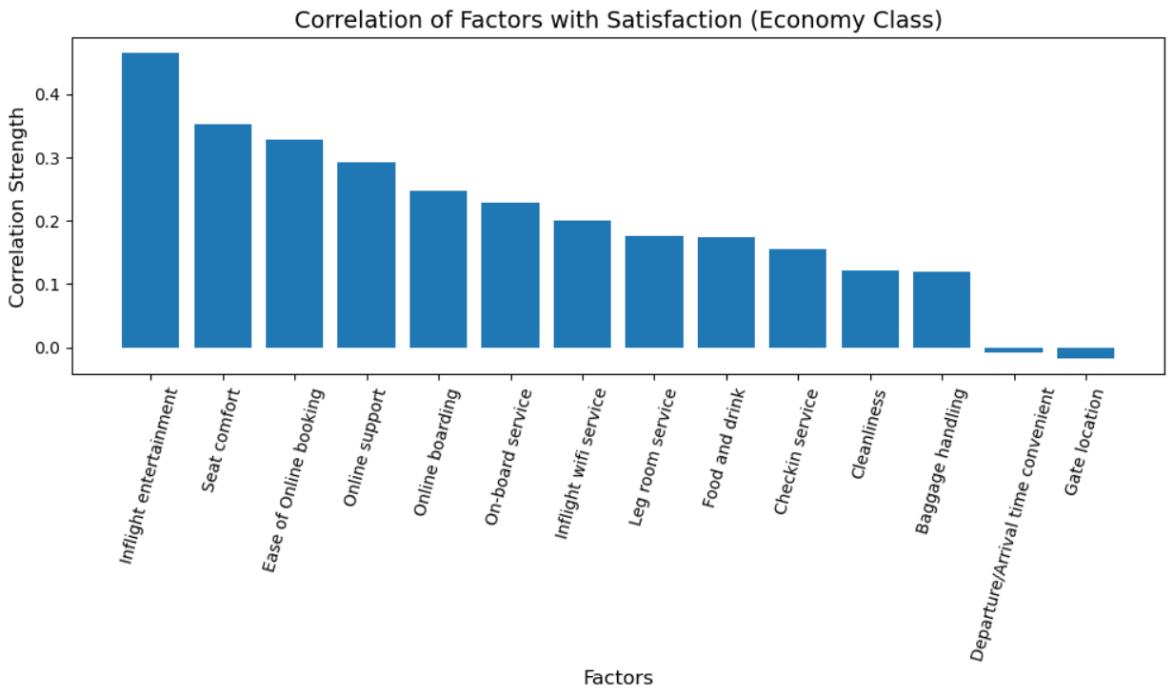
Economy Factor Correlation Analysis:
This bar chart suggests that Economy and Economy Plus, share the same top three factors.
Indicating the the two classes share similar values

Slide 16
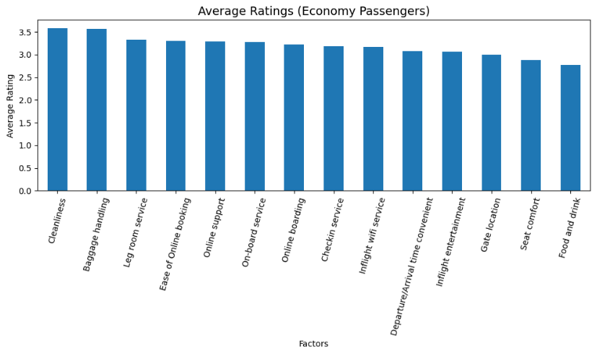
Economy Factor Average Rating:
These average ratings from Economy-Class passengers complement the earlier correlation results by showing that factors like cleanliness, baggage handling, and legroom are rated positively overall

Slide 17
Recommendation by Class:
Business Class:
Seat Comfort: Lower-rated compared to other Business Class services — improving comfort enhances the overall premium feel.
Food & Drink: Passengers expect higher quality at business class, so upgrading meals and presentation strengthens satisfaction.
Check-In Service: Enhancing speed, priority handling, and support improves the pre-flight experience for business travelers.
Economy-Plus and Economy Class:
Economy and Economy Plus have similar recommendations:
Food & Drink: Lowest-rated service — biggest opportunity to lift satisfaction.
Seat Comfort: Strong driver of satisfaction with below-average ratings — needs enhancement.
Inflight WiFi: Improves productivity and entertainment — moderate ratings indicate room to upgrade.

Slide 18
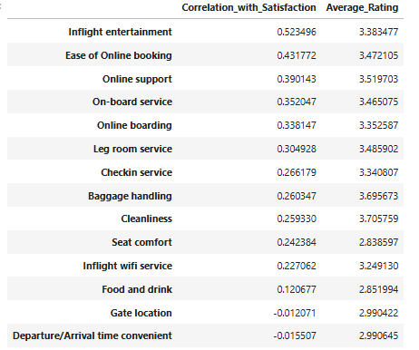
Overall Recommendation:
From this table we can derive strong influencing factors that airlines should focus on:
Enhancing inflight entertainment
Improve online experience
As well low rated factors that hold some influence on satisfaction that can improve such as:
Seat comfort
Food and drink

Slide 19
Next Steps:
Improvements to the charts, more descriptive
(colour, bubble chart, heat map)
Machine Learning Model:
Develop a machine learning model to further analyze our dataset and findings
These would include but not limited to:
Decision-Tree Classifier
Sentiment Intensity Analyzer
etc.

Slide 20
Conclusion:
Airlines must balance improvements between high-impact factors and fixing low-rated factors.
Key Findings:
Physical factors such as seat comfort often had low ratings
Online factors often fell in the top to top mid range of correlation
Overall insights
No factor scored above a 4 in their ratings, indicating there is a vast room for improvement throughout all factors
Economy and Economy plus having similar recommendations highlights that rather than class specific improvements, pattern based improvements are needed

Slide 21
Questions and Answers

